Slide 1
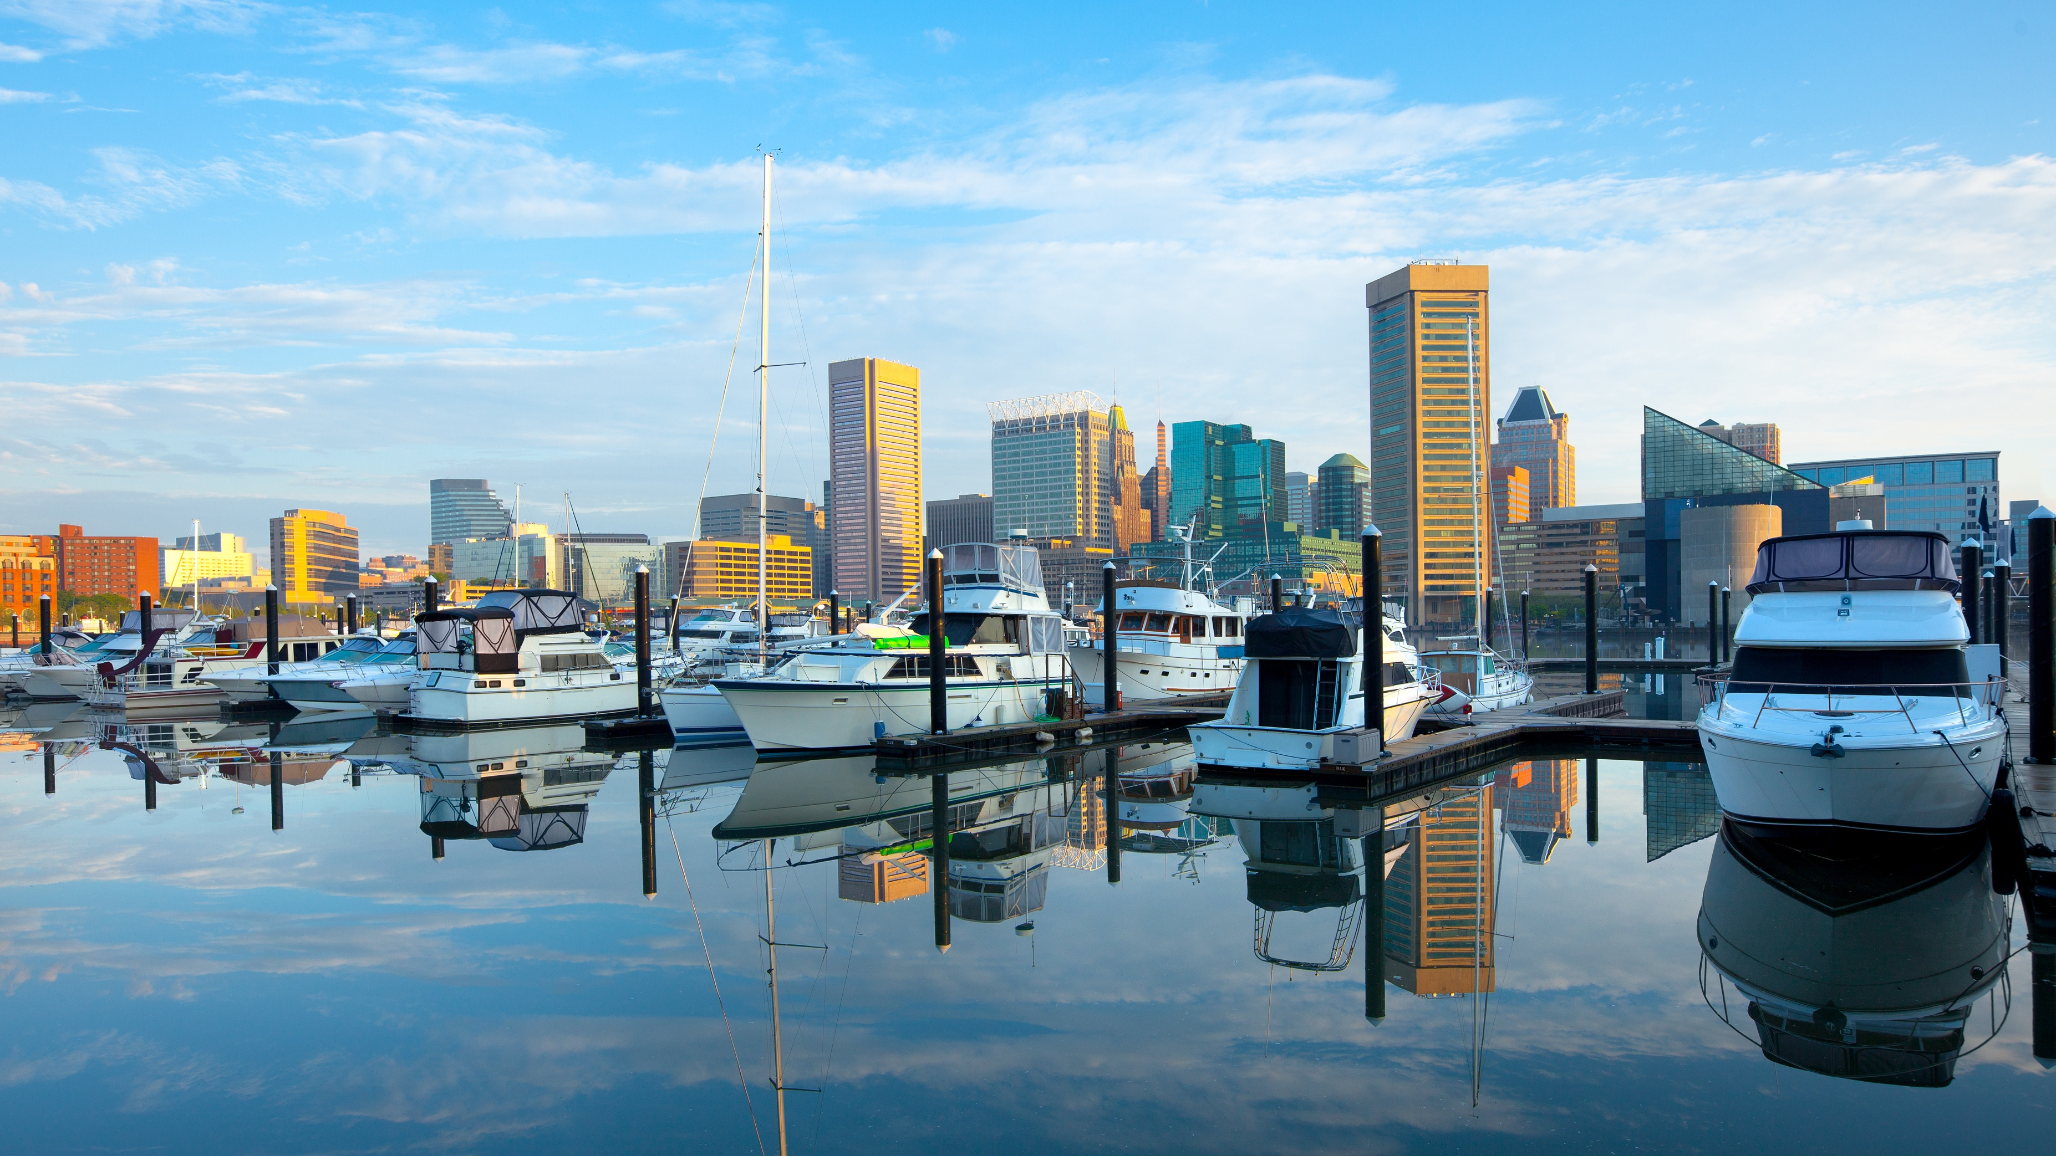


Working Group Meetings Baltimore
Working Group Meetings Baltimore
December 8-12, 2025 | Baltimore, MD
December 8-12, 2025 | Baltimore, MD

Slide 2

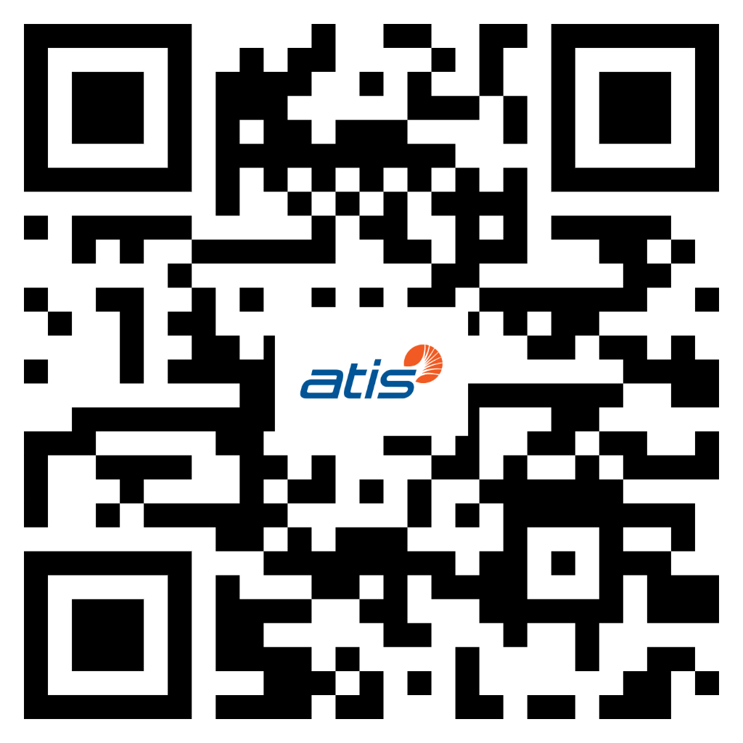
Visit the 3GPP Baltimore website for updated meeting information:
https://3gppmeetings.atis.org/Baltimore2025/
For inquiries during the meeting contact:
Baltimore2025@atis.org

Slide 3
Registration Desk
Location: Grand Ballroom Foyer
Badge Pickup Begins: Sunday, Dec 7 @ 2:00 PM
If possible, please pick up your badge on Sunday, Dec 7.
Register via the 3GPP Portal and pick up your badge at the ATIS Registration Desk.
Badges are required for entry to meeting spaces and coffee breaks.

Slide 4
Security/Registration
Delegates must pick up their badges at the Registration Desk in the Grand Ballroom Foyer. Please come on Sunday afternoon if you are able.
There is no QR code or scanning at the meeting rooms.
For security, only delegates wearing meeting lanyards with pre-printed badges will be permitted to enter the meeting rooms and coffee breaks.
Security is not provided in the meeting rooms; you are responsible for your own equipment.

Slide 5
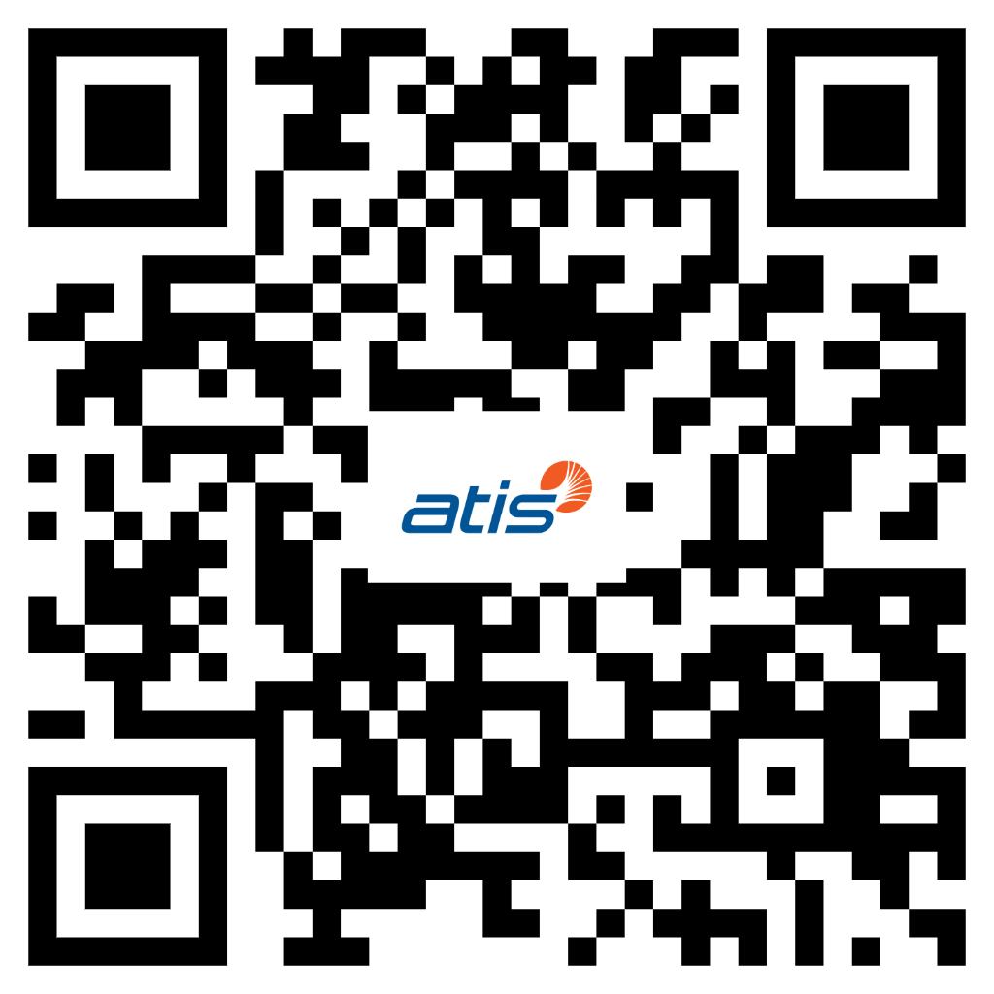
Visa Letters
You can pick up visa letters for the Calgary (Nov 26 WGs) and Boston (Dec 26 TSGs)
Location: Registration Desk, Grand Ballroom Foyer​
Visa Letter Pickup Hours:​
Tuesday-Thursday*: 9:00 AM – 5:00 PM​
Friday: 9:00 AM – 12:00 PM​
​
*All visa letter requests for in-person pickup must be submitted by 3 PM on Thursday. Scan the QR code above to apply for a visa letter.
​
All questions to do with visa letters should be directed to Jo Seibel at jseibel@atis.org (cc: visas@atis.org).​

Slide 6
Meeting Hours
There are limits on meeting times:
Monday: 9:00 AM – 7:30 PM
Tuesday/Wednesday/Thursday: 8:00 AM – 7:30 PM
Friday: 8:00 AM – 5:30 PM
*Please note, meeting times will be strictly observed to avoid incurring union overtime. Outside of the stipulated meeting hours, the venues’ AV, screens, projectors or microphones may not be used. Personal projectors may not be used at any time.
Please consult agenda documents for individual working groups for specific meeting times for each working group.

Slide 7
Coffee Breaks
Monday – Thursday
Morning Coffee Break: 10:30 AM – 11:00 AM
Afternoon Coffee Break: 3:30 PM – 4:00 PM
Break Location – Grand Ballroom Foyer
Friday
Morning Coffee Break (only): 10:30 AM – 11:00 AM
Break Location – Harborside Foyer

Slide 8

3GPP Welcome Drink Reception
Please join us Tuesday from 7:00-8:00 PM in the Grand Ballroom Foyer for a 3GPP Welcome Reception. Drink ticket may be found in the back of your name badge.

Slide 9

WiFi Info
Wireless LAN :
SSID: 3GPPWIFI
Password: 3GPP3GPPM (CAPITAL LETTERS!)
Server IP Address: 10.10.10.10
--> USUAL SETTING
Notes:
Same for both hotels

Slide 10
Welcome to Baltimore!
Explore Baltimore by visiting these top attractions
National Aquarium
Fort McHenry National Monument
Fells Point
Walters Art Museum
B&O Railroad Museum
Edgar Allen Poe House and Museum
George Peabody Library
Christmas Village in Baltimore
Inner Harbor Ice Rink
Pittsburgh Steelers @ Baltimore Ravens
1 PM ET on Sunday, December 7

Slide 11
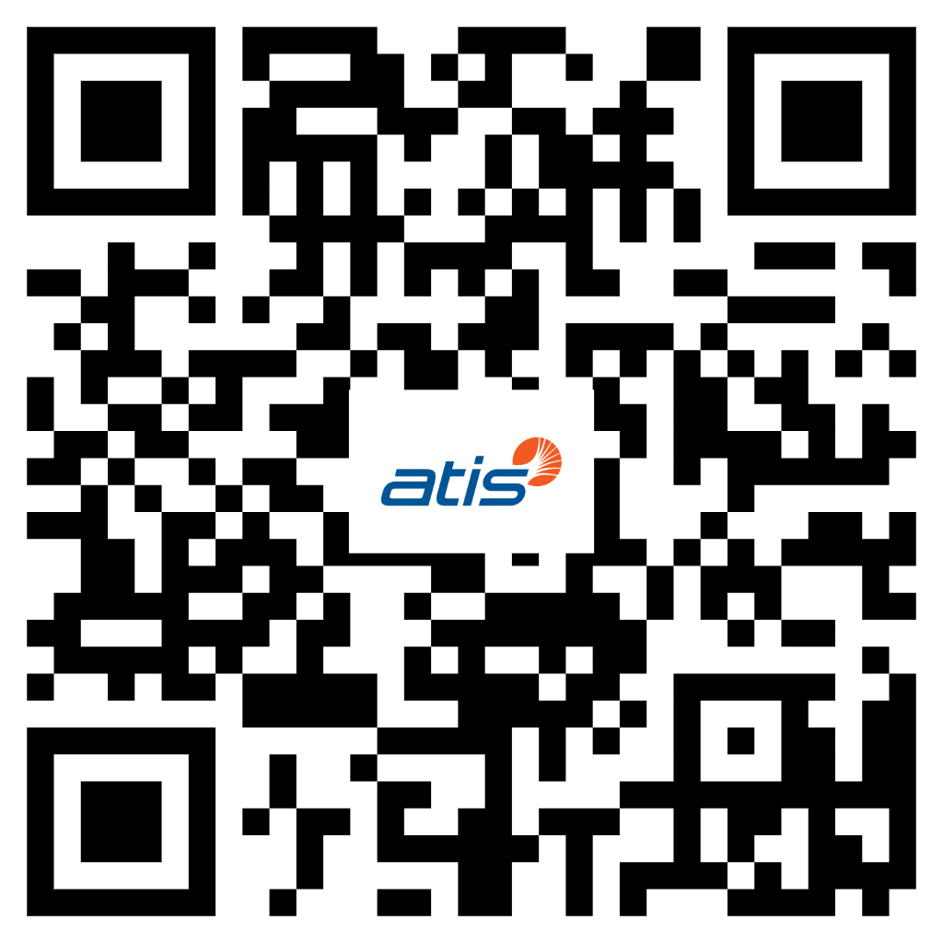
For more dining options visit our website:
Dining Options
Apropoe's Restaurant
Hours: 6:30 AM – 12:00 PM, 4:00 PM –10:00 PM
Apropoe's Coffee Shop
Hours: 6:30 AM – 3:00 PM
Apropoe's Bar
Hours: Sunday-Thursday | 3:00 PM – 12:00 AM
Friday-Saturday | 12:00 PM – 1:00 AM
The Ruxton Prime Steakhouse
James Joyce Irish Fare
The BLK Swan
Harbor East Deli
La Scala
McCormick & Schmick's Seafood & Steaks
The Capital Grille
The Oceanaire Seafood Room

Slide 12
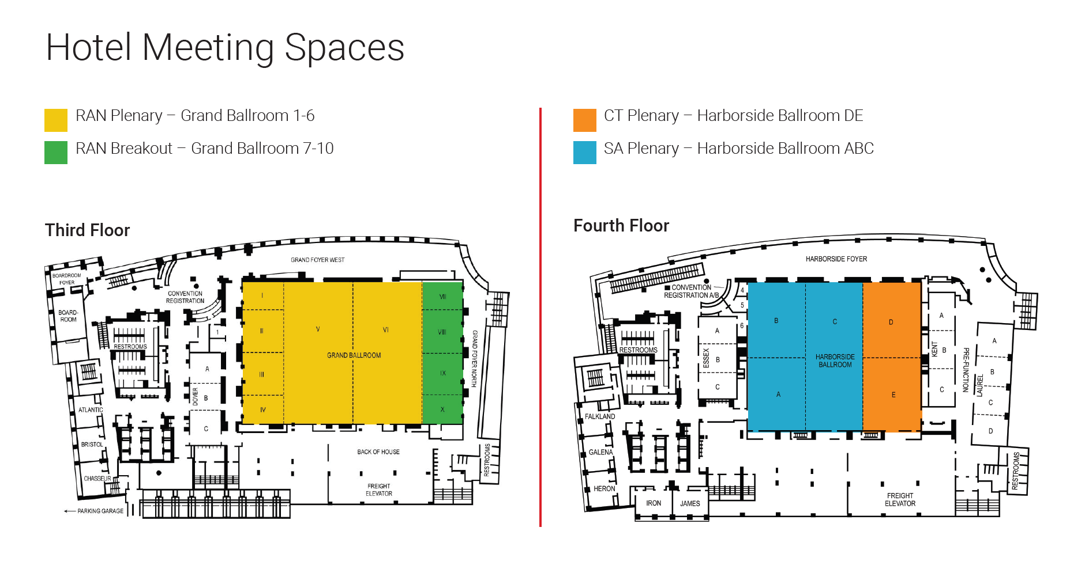
Venue Floor Plan
Notes:
Same for both hotels

Slide 13
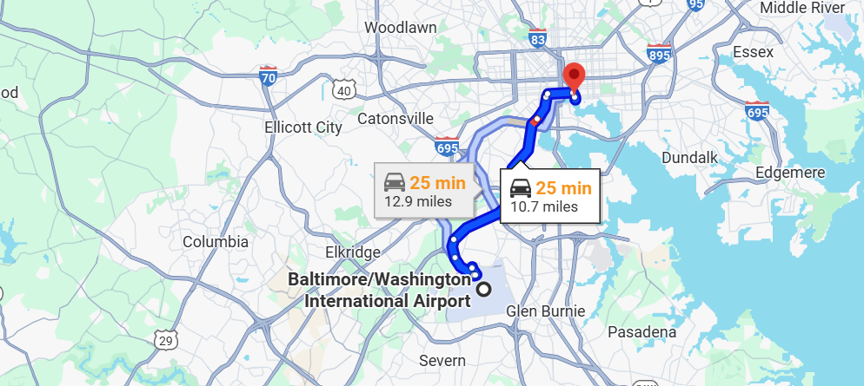
BWI Airport to Baltimore Marriott Waterfront
Baltimore Marriott Waterfront:
700 Aliceanna St.
Baltimore, MD 21202
+1 (410) 385-3000
Average Uber Cost: $25.00 USD
Notes:
Supplementary slide info

Slide 14
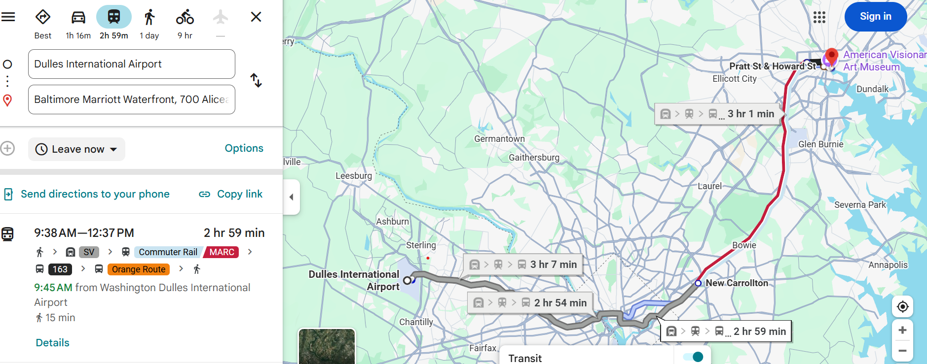
Dulles Airport (IAD) to Baltimore Marriott Waterfront
Baltimore Marriott Waterfront:
700 Aliceanna St.
Baltimore, MD 21202
Average Uber Cost: $105.00 USD
Notes:
Supplementary slide info

Slide 15
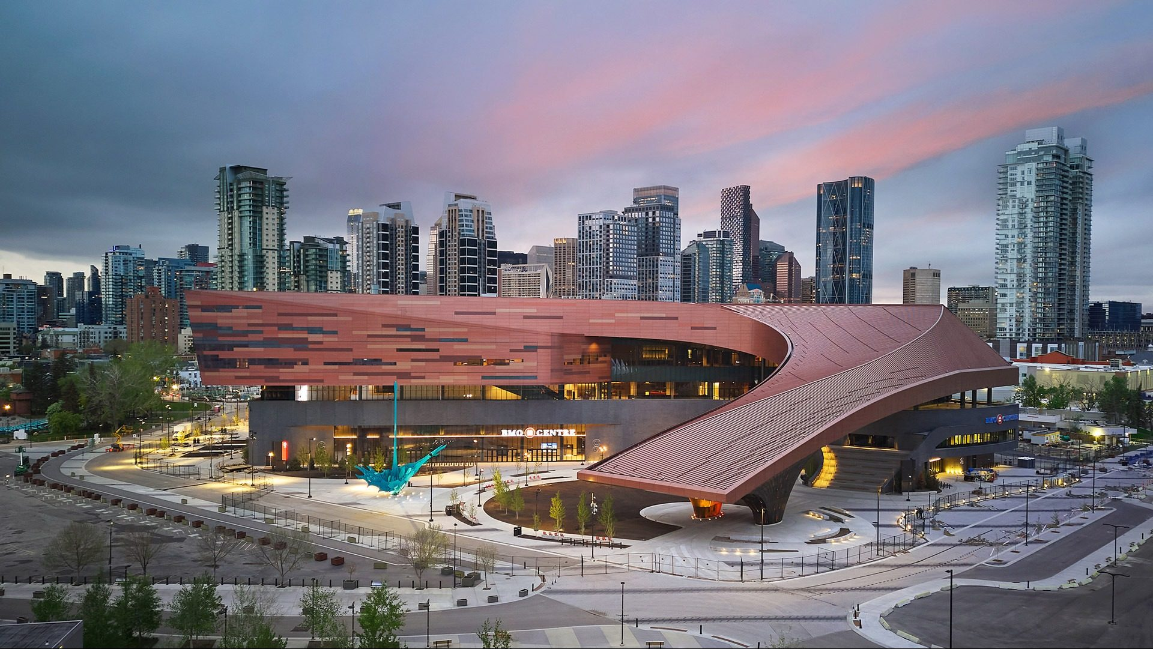

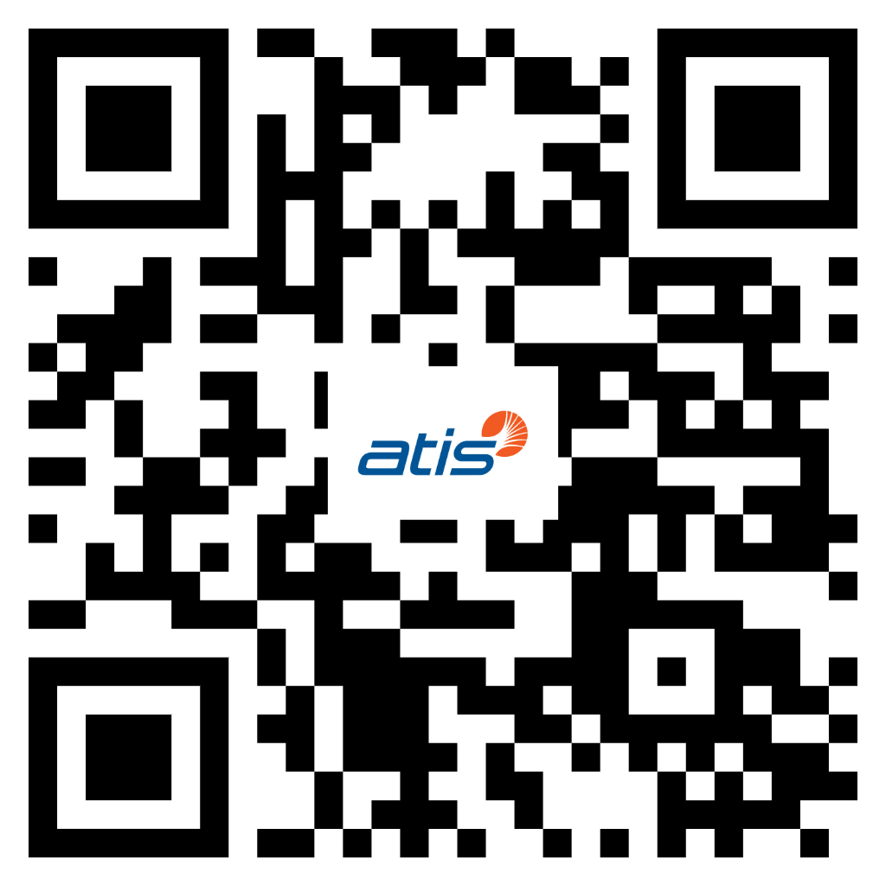
3GPP Working Group Meetings - Calgary November 16-20, 2026
Meeting Venue:
BMO Centre at the Calgary Stampede
1912 Flores Ladue Parade SE • Calgary, AB T2G 2W1, Canada
Visa Invitation Letter Request:
Delegates requiring visas are encouraged to register via the 3GPP Portal apply for their visa letter as soon as possible
https://portal.3gpp.org/#/

Slide 16
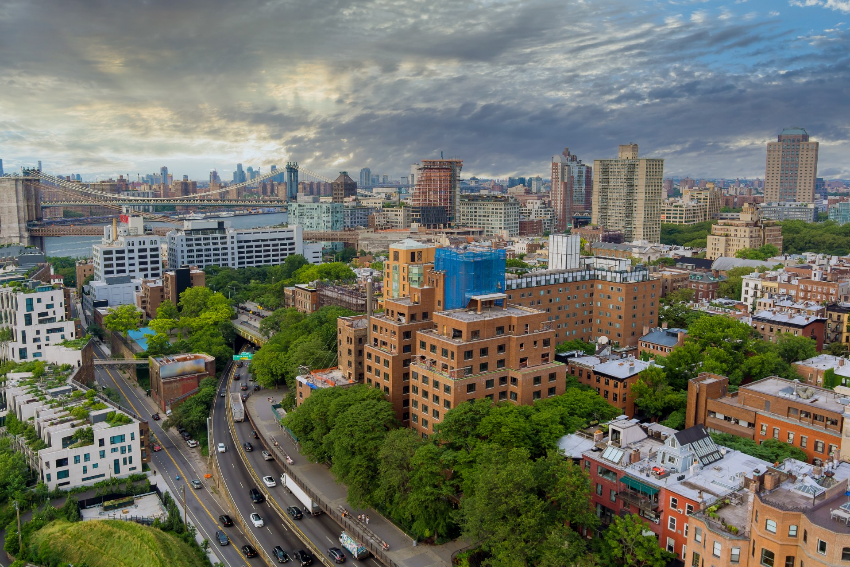
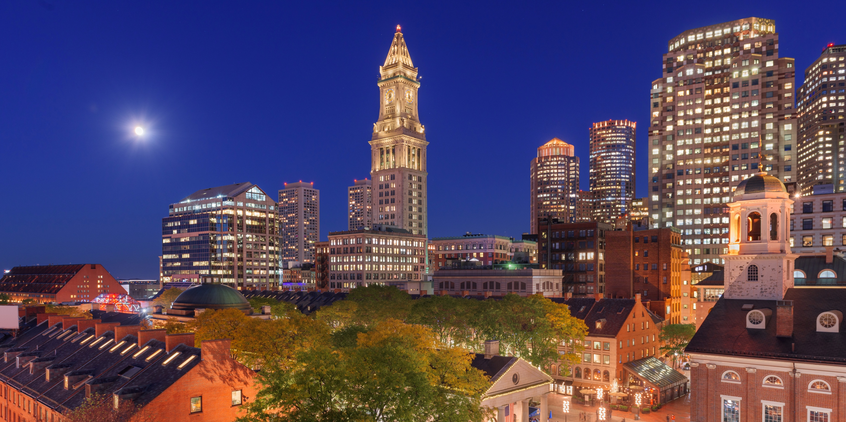
3GPP Plenary Meetings - Boston December 7-11, 2026
Meeting Venue:
Hilton Boston Park Plaza
Address: 50 Park Plaza, Boston, MA 02116
Visa Invitation Letter Request:
Delegates requiring visas are encouraged to register via the 3GPP Portal apply for their visa letter as soon as possible
https://portal.3gpp.org/#/
https://visas.3gppmeetings.atis.org/

Slide 17
ATIS Wishes 3GPP Delegates
A Successful Meeting
Notes:
Same for both hotels

